Slide 1
APUSH Review: The 13th – 15th Amendments
Period 5: 1844 – 1877
Everything You Need To Know About The 13th – 15th Amendments To Succeed In APUSH
Shoutouts to Alyssa S., Sophia L., Haley W., Chloe L., and Khush H. Thanks so much for your support. Best of luck, you’re brilliant!

Slide 2
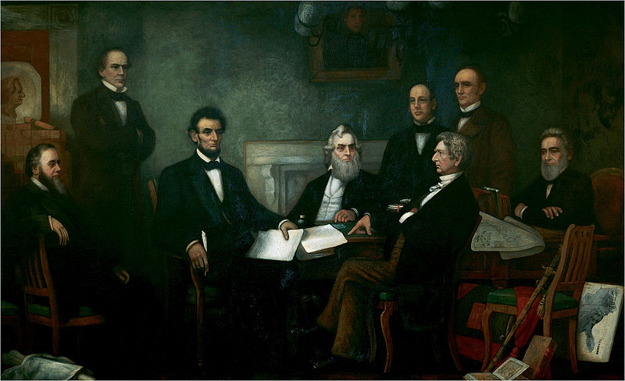
Background Info
The Emancipation Proclamation gave a moral cause to the Civil War
Lincoln worried that it would not be applicable post-Civil War
Republicans wanted to gain power in the South post Civil War
Radical Republicans sought to punish former Confederate leaders

Slide 3
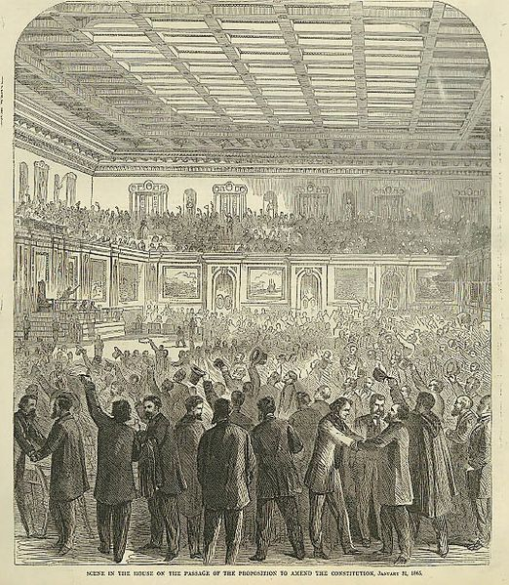
13th Amendment
What it says:
“Section 1. Neither slavery nor involuntary servitude, except as a punishment for crime whereof the party shall have been duly convicted, shall exist within the United States, or any place subject to their jurisdiction.
Section 2. Congress shall have power to enforce this article by appropriate legislation”
What the amendment did:
Abolished slavery EVERYWHERE in the US
Huge economic and social implications for the country

Slide 4
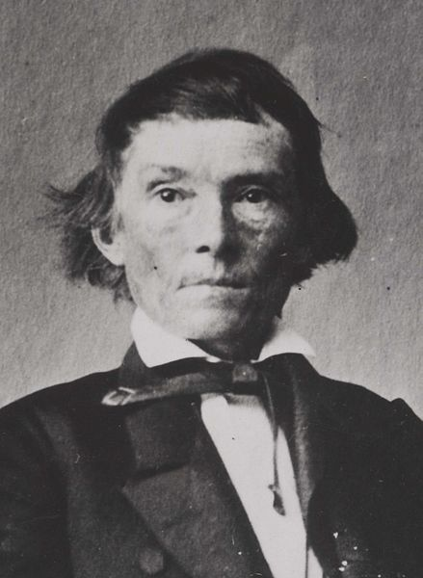
14th Amendment
What it says:
“Section 1. All persons born or naturalized in the United States, and subject to the jurisdiction thereof, are citizens of the United States and of the State wherein they reside. No State shall make or enforce any law which shall abridge the privileges or immunities of citizens of the United States; nor shall any State deprive any person of life, liberty, or property, without due process of law; nor deny to any person within its jurisdiction the equal protection of the laws.
Section 3. No person shall be a Senator or Representative in Congress, or elector of President and Vice President, or hold any office, civil or military, under the United States, or under any State, who, having previously taken an oath, as a member of Congress, or as an officer of the United States, or as a member of any State legislature, or as an executive or judicial officer of any State, to support the Constitution of the United States, shall have engaged in insurrection or rebellion against the same, or given aid or comfort to the enemies thereof. But Congress may, by a vote of two-thirds of each House, remove such disability.
What it did:
Section 1 – Born in the US? You’re a citizen (Overturned Dred Scott decision); equal protection of laws – used frequently in the future
Section 3 – Confederate officials could not hold US office – sorry Alexander Stephens

Slide 5
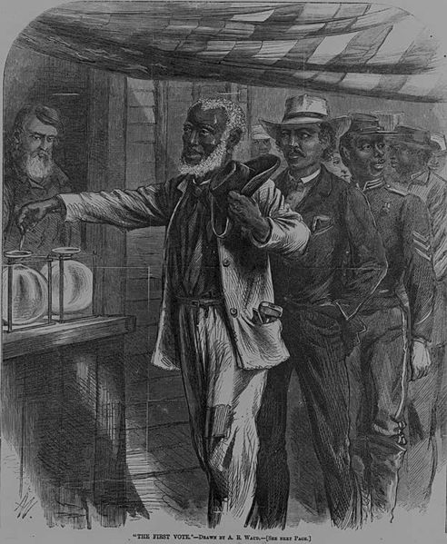
15th Amendment
What it says:
“Section 1. The right of citizens of the United States to vote shall not be denied or abridged by the United States or by any State on account of race, color, or previous condition of servitude.
Section 2. The Congress shall have power to enforce this article by appropriate legislation”
What it did:
Provided suffrage for African American males
Helped provide for large Republican support from blacks in the South

Slide 6
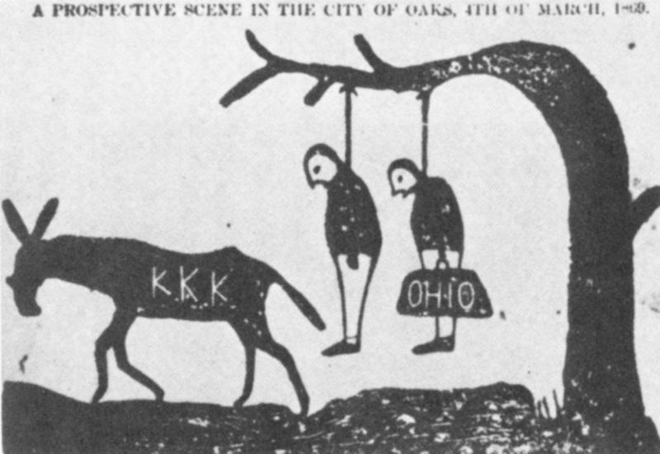
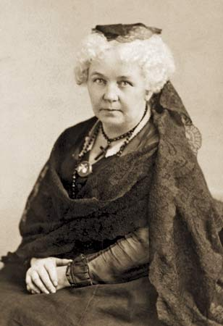
Impacts of the Amendments
Women’s Rights Movement:
The 14th and 15th amendments divided the group
Frederick Douglass and others favored black suffrage PRIOR to women’s suffrage
Lucy Stone and the American Women Suffrage Association hoped to achieve suffrage after Reconstruction
Elizabeth Cady Stanton feared suffrage was not likely near, National Woman Suffrage Association advocated an amendment for women’s suffrage
Ways Southern states got around the amendments:
Segregation
Violence – KKK intimidated many southern blacks and discouraged voting
Supreme Court decisions:
Civil Rights Cases – Congress could not prohibit discrimination by private businesses and individuals
Plessy v. Ferguson – upheld separate but equal facilities
Local political tactics:
Poll taxes, literacy tests, and grandfather clauses
Eventually, these amendments were used in court decisions that upheld civil rights
Brown v. Board of Education, court cases of the 1960s (Warren Court) that increased rights of the accused

Slide 7
Test Tips
Multiple-Choice and Short Answer Questions:
Ways Southern states got around the 14th and 15th amendments
Impact of the 14th amendment on women’s rights groups
Essay Questions:
Comparing the effectiveness of amendments over time (how the Civil Rights Era of the 1950s and 1960s completed the goals of the amendments)

Slide 8
Thanks for watching!
Subscribe to my channel
Help spread the word
Questions? Comments?
Leave in comments
I’m Salmon P. Chase and I’m from Cincinnati! Go Reds!
Subscribe
Down here!

